Slide 1
Advance Blackbox testing techniques
Naseem us Sehar

Slide 2
State Transition Testing
State Transition testing, a black box testing technique, in which outputs are triggered by changes to the input conditions or changes to 'state' of the system. In other words, tests are designed to execute valid and invalid state transitions.
State Transition testing is a Black-box testing technique, which can be applied to test ‘Finite State Machines’.
A ‘Finite State Machine (FSM)’ is a system that will be in different discrete states (like “ready”, “not ready”, “open”, “closed”,…) depending on the inputs or stimuli.

Slide 3
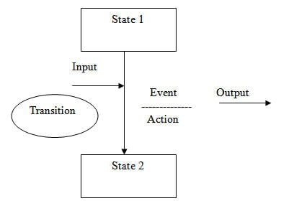
State transition technique is a dynamic testing technique, which is used when the system is defined in terms of a finite number of states and the transitions between the states are governed by the rules of the system.

Slide 4
ATM example
You visit an ATM and withdraw $1000. You get your cash. Now you run out of balance and make exactly the same request of withdrawing $1000. This time ATM refuses to give you the money because of insufficient balance. So, here the transition, which caused the change in state is the earlier withdrawal

Slide 5
When to use State transition testing
When the application under test is a real-time system with different states and transitions encompassed.
When the application is dependent upon the event/values/conditions of the past.
When the sequence of events needs to be tested.
When the application needs to be tested against a finite set of input values.

Slide 6
When we shouldn’t use State transition Testing
When testing is not required for sequential input combinations.
When different functionalities of the application are required to be tested (more like Exploratory testing).
When no of states are not finite

Slide 7
Example
Software name – Manage_display_changes Specifications – The software responds to input requests to change display mode for a time display device.
The Display mode can be set to one of the four values:
Two corresponding to displaying either the time or date.
The other two when altering either the time or the date.

Slide 8
States of the system
The different states are as follows:
Change Mode (CM): Activation of this shall cause the display mode to move between “display time (T)” and “display date (D)”.
Reset (R): If the display mode is set to T or D, then a “reset” shall cause the display mode to be set to “alter time (AT)” or “alter date (AD)” modes.
Time Set (TS): Activation of this shall cause the display mode to return to T from AT.
Date Set (DS): Activation of this shall cause the display mode to return to D from AD.

Slide 9
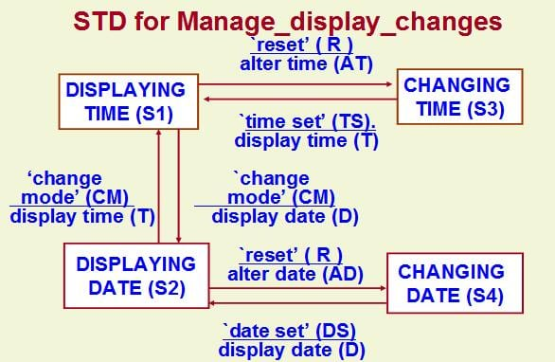
State Transition Diagram

Slide 10
Interpretation
#1) States are:
Display Time(S1),
Change Time(S3),
Display Date(S2), and
Change Date (S4).
#2) Inputs are:
Change Mode(CM),
Reset (R),
Time Set(TS),
Date Set(DS).

Slide 11
#3) Outputs are:
Alter Time(AT),
Display Time(T),
Display Date(D),
Alter Date (AD).
#4) The Changed States are:
Display Time(S1),
Change Time (S3),
Display Date (S2) and
Change Date (S4).

Slide 12
Step 1: Write all of the start states. For this, take one state at a time and see how many arrows are coming out from it.
For State S1, there are two arrows coming out of it. One arrow is going to state S3 and another arrow is going to state S2.
For State S2 – There are 2 arrows. One is going to State S1 and other going to S4
For State S3 – Only 1 arrow is coming out of it, going to state S1
For State S4 – Only 1 arrow is coming out of it, going to state S2

Slide 13

Let’s put this in table:
Since for state S1 and S2, there are two arrows coming out, we have written it twice.

Slide 14
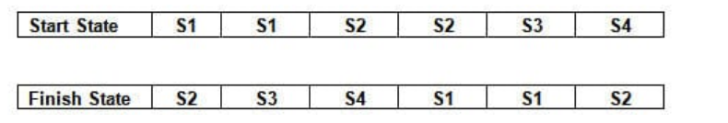
Step -2: For each state, write down their final transitioned states.
For state S1 – The final states are S2 and S3
For State S2 – The final states are S1 and S4
For State S3 – The final state is S1
For State S4 – Final State is S2
Put this on the table as an Output/Resultant state.

Slide 15
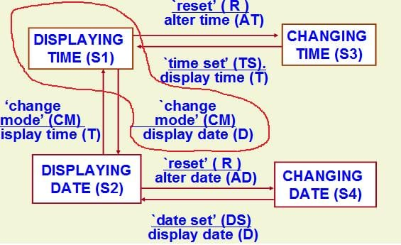
Step 3: For each start state and its corresponding finish state, write down the input and output conditions
For state S1 to go to state S2, the input is Change Mode (CM) and output is Display Date(D) shown below:

Slide 16
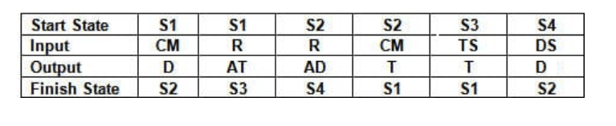
In a similar way, write down the Input conditions and its output for all the states as follows:

Slide 17
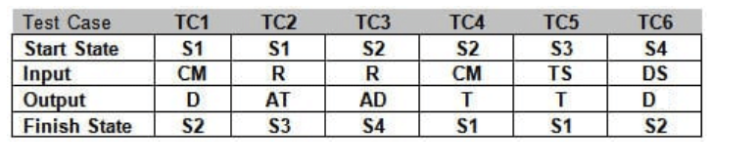
Step 4:
Now add the test case ID for each test shown below:

Slide 18
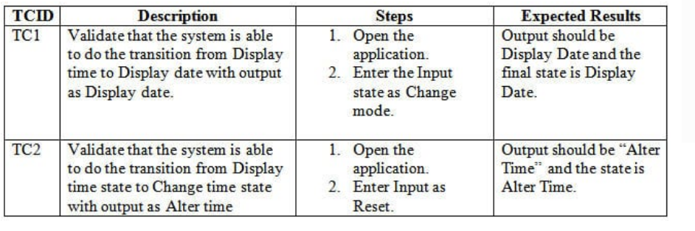
Now let’s convert it to formal test cases:

